Slide 1
Work Study & Method Engineering

Slide 2
Work Measurement/Time Study
Work measurement is also called by the name ‘time study’. Work measurement is absolutely essential for both the planning and control of operations.
Without measurement data, we cannot determine the capacity of facilities or it is not possible to estimate delivery dates or costs.
We are not in a position to determine the rate of production and also labour utilization and efficiency.
It may not be possible to introduce incentive schemes and standard costs for budget control.

Slide 3
Objectives
The use of work measurement as a basis for incentives is only a small part of its total application. The objectives of work measurement are to provide a sound basis for:
1. Comparing alternative methods.
2. Assessing the correct initial manning (manpower requirement planning).
3. Planning and control.
4. Realistic costing.
5. Financial incentive schemes.
6. Delivery date of goods.
7. Cost reduction and cost control.
8. Identifying substandard workers.
9. Training new employees.

Slide 4
Techniques of Work Measurement
For the purpose of work measurement, work can be regarded as:
Repetitive work: The type of work in which the main operation or group of operations repeat continuously during the time spent at the job. These apply to work cycles of extremely short duration.
Non-repetitive: It includes some type of maintenance and construction work, where the work cycle itself is hardly ever repeated identically.
Various techniques of work measurement are:
Time study (stop watch technique),
Work sampling,
Predetermined motion and time study,
Analytical estimating.

Slide 5
Techniques of Work Measurement
Time study and work sampling involve direct observation and the remaining are data based and analytical in nature.
1. Time study: A work measurement technique for recording the times and rates of
working for the elements of a specified job carried out under specified conditions and for analyzing the data so as to determine the time necessary for carrying out the job at the defined level of performance. In other words measuring the time through stop watch is called time study.

Slide 6
Techniques of Work Measurement
2. Work sampling: A technique in which a large number of observations are made over a period of time of one or group of machines, processes or workers. Each observation records what is happening at that instant and the percentage of observations recorded for a particular activity, or delay, is a measure of the percentage of time during which that activities delay occurs.
3. Predetermined motion time study (PMTS): A work measurement technique whereby times established for basic human motions (classified according to the nature of the motion and conditions under which it is made) are used to build up the time for a job at the defined level of performance. The most commonly used PMTS is known as Methods Time Measurement (MTM).
4. Analytical estimating: A work measurement technique, being a development of estimating, whereby the time required to carry out elements of a job at a defined level of performance is estimated partly from knowledge and practical experience of the elements concerned and partly from synthetic data.

Slide 7
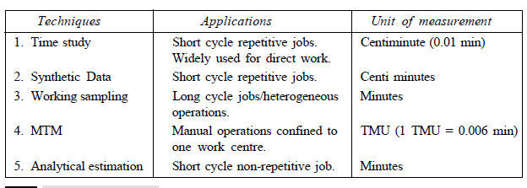
Techniques of Work Measurement
The work measurement techniques and their applications are shown in Table

Slide 8
Time Study
Time study is also called work measurement. It is essential for both planning and control of operations.
According to British Standard Institute time study has been defined as “The application of techniques designed to establish the time for a qualified worker to carry out a specified job at a defined level of performance.”

Slide 9
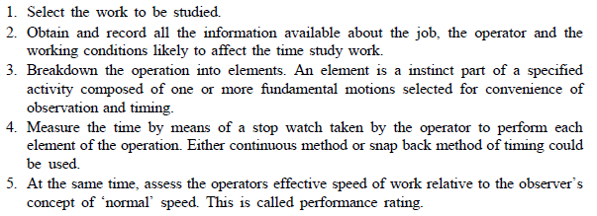
Steps in Making Time Study
Stop watch time is the basic technique for determining accurate time standards. They are economical for repetitive type of work.
Steps in taking the time study are:

Slide 10
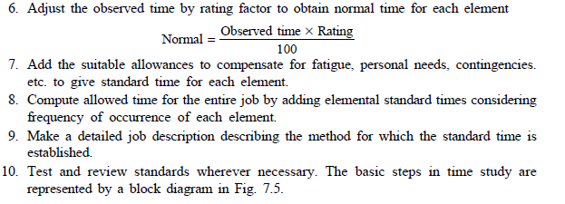
Steps in Making Time Study

Slide 11
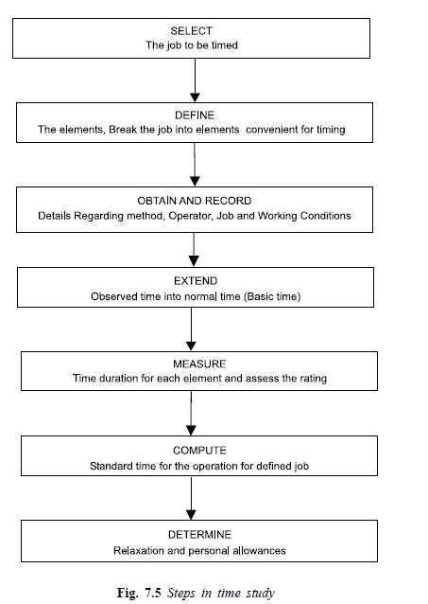
Computation of Standard Time

Slide 12
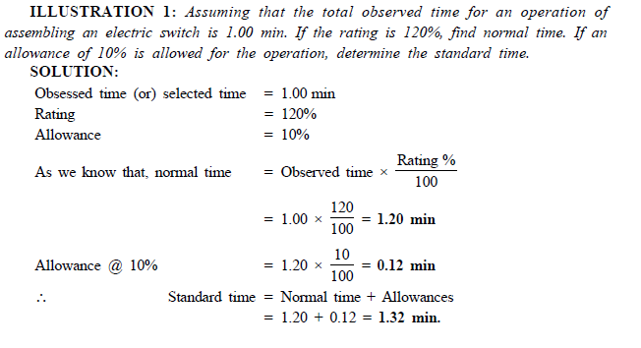
Example

Slide 13
Computation of Standard Time
Standard time is the time allowed to an operator to carry out the specified task under specified conditions and defined level of performance.
The various allowances are added to the normal time as applicable to get the standard time as shown in Fig. 7.6.
Standard time may be defined as the, amount of time required to complete a unit of work:
Under existing working conditions,
Using the specified method and machinery,
By an operator, able to the work in a proper manner, and
At a standard pace.

Slide 14
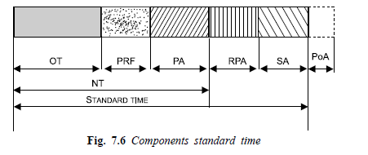
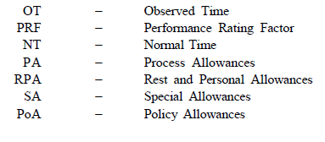
Computation of Standard Time

Slide 15
Computation of Standard Time
Thus basic constituents of standard time are:
Elemental (observed time).
Performance rating to compensate for difference in pace of working.
Relaxation allowance.
Interference and contingency allowance.
Policy allowance

Slide 16
Allowances
The normal time for an operation does not contain any allowances for the worker.
It is impossible to work throughout the day even though the most practicable, effective method has been developed.
Even under the best working method situation, the job will still demand the expenditure of human effort and some allowance must therefore be made for recovery from fatigue and for relaxation.
Allowances must also be made to enable the worker to attend to his personal needs. The allowances are categorized as:
(1) Relaxation allowance, (2) Interference allowance, and (3) Contingency allowance and (4) Policy allowance

Slide 17
1. RELAXATION ALLOWANCE
Relaxation allowances are calculated so as to allow the worker to recover from fatigue.
Relaxation allowance is a addition to the basic time intended to provide the worker with the opportunity to recover from the physiological and psychological effects of carrying out specified work under specified conditions and to allow attention to personal needs.
The amount of allowance will depend on nature of the job.
Relaxation allowances are of two types:
Fixed allowances,
Variable allowances.

Slide 18
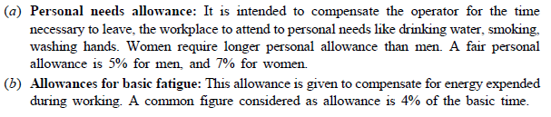
i. Fixed allowances
Fixed allowances constitute:

Slide 19
ii. VARIABLE ALLOWANCE
Variable allowance is allowed to an operator who is working under poor environmental conditions that cannot be improved, added stress and strain in performing the job.
The variable fatigue allowance is added to the fixed allowance to an operator who is engaged on medium and heavy work and working under abnormal conditions.
The amount of variable fatigue allowance varies from organization to organization.

Slide 20
2. INTERFERENCE ALLOWANCE
It is an allowance of time included into the work content of the job to compensate the operator for the unavoidable loss of production due to simultaneous stoppage of two or more machines being operated by him.
This allowance is applicable for machine or process controlled jobs.
Interference allowance varies in proportion to number of machines assigned to the operator.
The interference of the machine increases the work content.

Slide 21
3. CONTINGENCY ALLOWANCE
A contingency allowance is a small allowance of time which may be included in a standard time to meet legitimate and expected items of work or delays.
The precise measurement of which is uneconomical because of their infrequent or irregular occurrence.
This allowance provides for small unavoidable delays as well as for occasional minor extra work

Slide 22
3. CONTINGENCY ALLOWANCE
Some of the examples calling for contingency allowance are:
Tool breakage involving removal of tool from the holder and all other activities to insert new tool into the tool holder.
Power failures of small duration.
Obtaining the necessary tools and gauges from central tool store. Contingency allowance should not exceed 5%.

Slide 23
4. POLICY ALLOWANCE
Policy allowances are not the genuine part of the time study and should be used with utmost care and only in clearly defined circumstances.
The usual reason for making the policy allowance is to line up standard times with requirements of wage agreement between employers and trade unions.
The policy allowance is an increment, other than bonus increment, applied to a standard time (or to some constituent part of it, e.g.,
Policy allowances are sometimes made as imperfect functioning of a division or part of a plant.

Slide 24
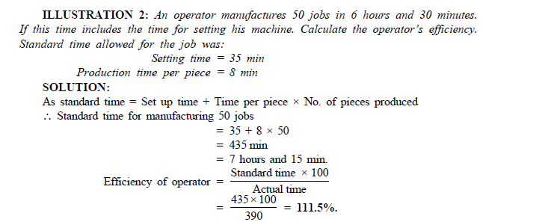
Examples

Slide 25
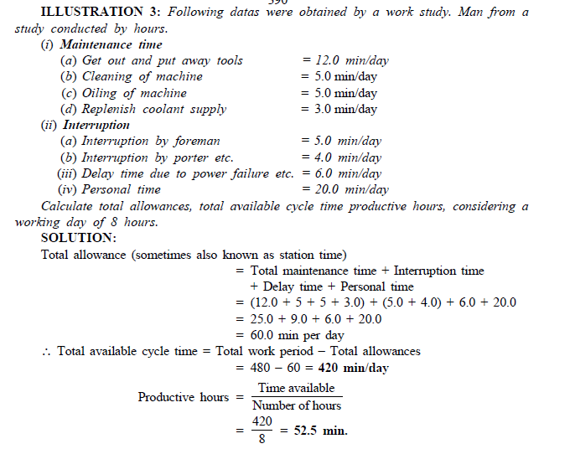
Examples

Slide 26
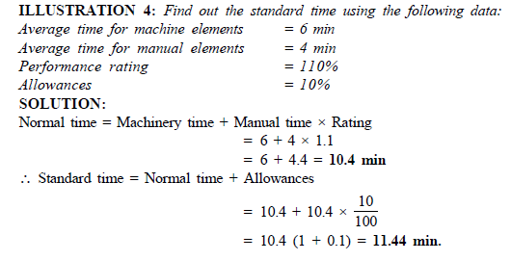
Examples

